Slide 1


K.RAMAKRISHNAN COLLEGE OF TECHNOLOGY
(AUTONOMOUS), TRICHY.
DEPARTMENT OF
COMPUTER SCIENCE AND ENGINEERING
20CS5501 DESIGN PROJECT-1
Batch No. : 18
Date : 06.12.2024

Slide 2
MEDICATION REMAINDER
Guided by Team
Mrs.V.Kalpana Niranjini C (811722104102)
Assistant Professor, CSE Nithya Sree D (811722104105)
Rajeswari M (811722104118)

Slide 3
OBJECTIVE OF THE PROJECT
The primary objective of a medication reminder project is to design and develop a system that sends timely reminders to patients to take their prescribed medications, thereby improving medication adherence and reducing missed doses.
Medication Reminder aims to enhance patient outcomes by ensuring consistent medication intake, which is crucial for managing chronic conditions and preventing adverse health consequences.
By providing personalized reminders and tracking medication intake, the system seeks to empower patients to take control of their medication regimen and improve their overall health and well-being..
It aims to create a user-friendly and customizable platform that sends reminders and notifications to users via various channels, such as SMS, email, or mobile app notifications.

Slide 4
ABSTRACT
Mobile technologies are finding a role in patient monitoring in several different environments: homes,hospitals, and nursing homes.health applications include the use of mobile devices in collecting community and clincal health data delivery of healthcare information to practitioner's researchers and paitents,real-time monitoring of patient's vital signs, and direct provision of care. Therefore, usability of software applications is the key to success of any system. This study focussed on creating an application for smart phones with android system. The main aim of the proposed system is to help two important categories of the society they are elderly and Alzheimer’s patients, these two categories shared in one recipe which is a forgetful. The design of the proposed system presented in this study includes remanding them of the dates of their medications.

Slide 5
LITERATURE SURVEY
TITLE OF THE PAPER | AUTHOR (S) | PUBLISHER | PAPER GIST | TECHNOLOGY USED
Smart medicines reminder box | Sanjay Bhati,Harshid Soni | IEEE conference publication (2020) | The paper introduces a smart medication reminder box designed to enhance medication adherence through automation and connectivity. | NLP, Reinforcement learning
Cloud computing based Medical Assistance and pill Reminder | A Chinnasamy, Syed Rafeeq Ahmed, S Akash | International Conference on Intelligent Computing and Control systems. (2022) | This paper leverage cloud technologies to enhance healthcare delivery and patient compliance with medication schedules. | Machine learning, Cloud computing, Optimization algorithm
An automated and online-based medicine reminder and dispenser | Shayla Sharmin,Md Ibrahim Khulil Ullah Ratan,Ashraful Haque Piash | International conference on Big data,Iot and Machine learning (2022) | The system integrates a web or mobile platform that sends reminders to patients about dosage times while also dispensing the correct medication automatically. | IOT and Sensor integration algorithm, Cloud based data sync algorithms

Slide 6
TITLE OF THE PAPER | AUTHOR(S) | PUBLISHER | PAPER GIST | TECHNOLOGY USED
Medication Reminder Device for the Elderly Patients With Mild Cognitive Impairment | Rina ishiwita,MS,Tomoko Kamimura,PHD,takenobu inonue,MS | American journal of Alzheimer’s Disease and other Dementias | A medication reminder device is a tool that uses an alarm cue to prompt users to take medication | Machine learning, optimized learning
Medication adherence by using a hybrid automatic reminder machine | Ying-Wen Bai, Ting-Hsuan Kuo | 2016 IEEE International Conference | This paper explores the development and application of a hybrid automatic reminder machine that leverages IoT, AI, and automated dispensing technologies to improve medication adherence. | IOT,AI Powered reminder systems
IoT-Based Real-Time Medicine Reminder and Dispenser for Elderly Patients | Arafath Al Hossain Abdul Awal Tanvir Safwan Sulaiman Sadi | 2024 second world conference | This paper presents an IoT-based real-time medicine reminder and dispenser designed to aid elderly patients by automating medication schedules, providing timely alerts, and ensuring proper dosage. | IOT, cloud computing

Slide 7
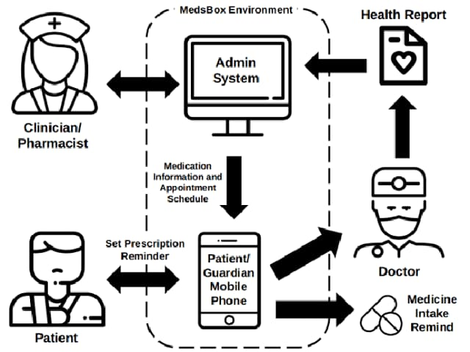
PROPOSED SYSTEM ARCHITECTURE

Slide 8
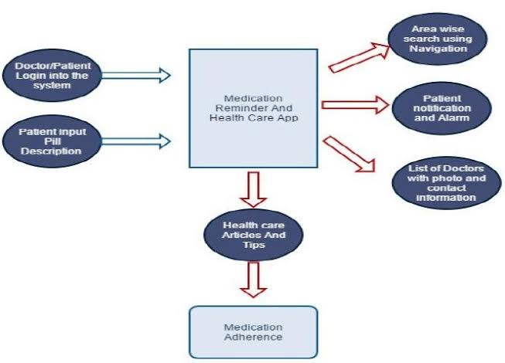
EXISTING SYSTEM ARCHITECTURE

Slide 9
SOFTWARE AND HARDWARE REQUIREMENTS
HARDWARE
SOFTWARE
Processer : Duel core processor
2.6.0 GHZ
RAM : 4GB
Hard disk : 320GB
Compact disk : 650MB
Keyboard : standard
Keyboard Operating System : windows
Front End : Android,java
Back End : java
Tool : Android studio

Slide 10
MODULES
Add Medication Reminder
Alert Received Patients
Alert Get Caretaker

Slide 11
SUMMARY OF MODULE-1
Add Medication Reminder:
The Medicine Reminder Module is a crucial component of healthcare and wellness applications designed to help users manage their medication schedules effectively. This module provides users with features to set up reminders for taking medications, ensuring adherence to prescribed regimens and improving overall health outcomes.

Slide 12
SUMMARY OF MODULE-2
Alert Received Patients :
Receiving an alert about a patient module related to Alzheimer's likely the patient update medicine details taken or ignore. Medication Reminder application ensures that patients are notified about their medication schedules and any important updates regarding their treatment plan. The backend system manages the scheduling and dispatching of alerts based on user-defined preferences and medication schedules.

Slide 13
SUMMARY OF MODULE-3
Alert Get Caretaker:
The Alert Send Module is a vital component of communication systems and applications, facilitating the efficient dissemination of alerts, notifications, and emergency messages to designated recipients or user family member. If the user is somewhere else, the family member receives an alert message.

Slide 14
RESULTS AND DISCUSSION
The medication reminder project demonstrated significant success in enhancing medication adherence and optimizing reminder delivery systems. The system consistently delivered notifications at scheduled times, with prompt response times from users, ensuring effective engagement. Testing showed a noticeable improvement in medication adherence rates, highlighting the project's positive impact on compliance.The system operated reliably throughout the testing period, maintaining a high level of performance with only occasional disruptions caused by external factors such as network connectivity.

Slide 15
CONCLUSION
The healthcare app is a shining example of innovation in the field of medical technology, providing a thorough answer to a wide range of issues that both patients and healthcare professionals encounter.
The software has the potential to greatly enhance patient outcomes and healthcare accessibility by enabling remote consultations and monitoring, especially for marginalized populations or those with restricted mobility.
Medication reminder creates confidence in patients and healthcare professionals by adhering to strict security policies and regulatory regulations that guarantee the confidentiality and integrity of user data.
The app is a critical step towards a future where technology seamlessly integrates with healthcare, enabling people to take charge of their well-being.

Slide 16
THANK YOU

